Slide 1


IТ Образование
Для специалистов всех уровней!
WWW.ITEDUCATE.COM.UA

Slide 2


Administering Apache Tomcat 7
фото
Set up and configure Apache Tomcat 7
Коваленко Вадим
Deploy Java web applications
Unix\Linux trainer
Configure Tomcat logs and troubleshoot Tomcat
Build Tomcat cluster
Secure Tomcat

Slide 3
Introduction

Slide 4

Architecture
What we want !!!
Tomcat
Apache httpd server
internet
mod_jk load balancer
Tomcat
Tomcat
static resources
dynamic resources

Slide 5
The evolution of the web
●
1989 – the birth of the web
●
Tim Berners-Lee
distributed information system for CERN physicists and engineers
●
●
1990 – the first web page
●
was about the WWW project
–
World Wide Web
●
no screen-shot of the original page

Slide 6
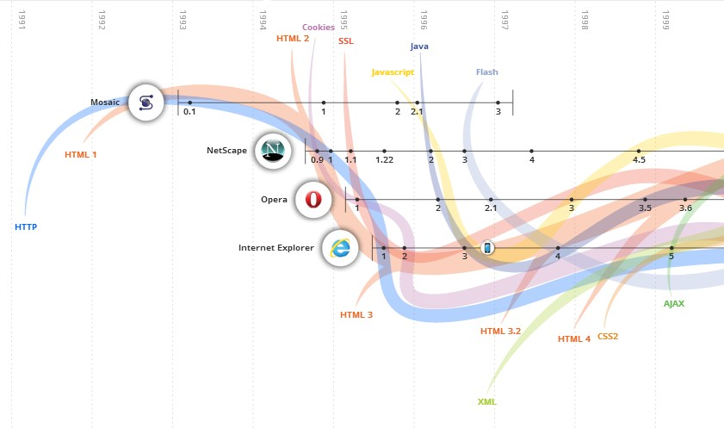
The evolution of the web(cont.)
●
source : http://evolutionofweb.appspot.com/

Slide 7
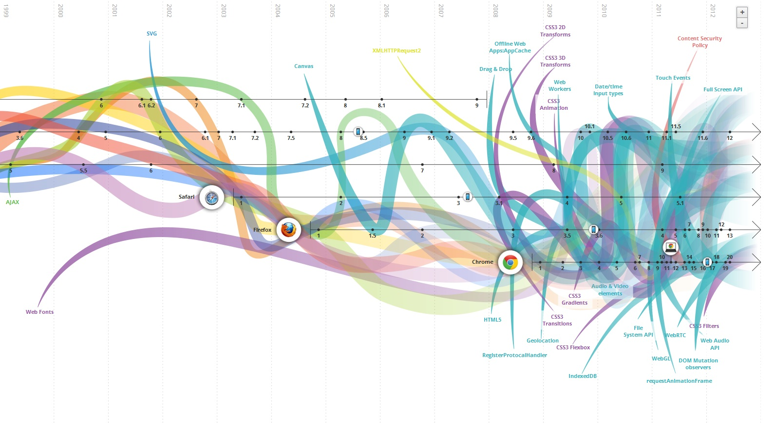
The evolution of the web(cont.)

Slide 8
Web server
●
Primary function : to deliver web pages to clients
●
HTTP : communication protocol between client and server
●
Commons features
●
Virtual hosting to serve many sites using one IP address Server-side scripting to generate dynamic web pages
●
–
CGI, Fast CGI, SSI, …
●
Bandwidth throttling

Slide 9
Web server(cont.)
●
Market share
Product | Vendor | April 2014 | Percent | May 2014 | Percent | Change
Apache | Apache | 361,853,003 | 37.74% | 366,262,346 | 37.56% | -0.18%
IIS | Microsoft | 316,843,695 | 33.04% | 325,854,054 | 33.41% | +0.37%
nginx | NGINX, Inc. | 146,204,067 | 15.25% | 142,426,538 | 14.60% | -0.64%
GWS | Google | 20,983,310 | 2.19% | 20,685,165 | 2.12% | -0.07%
Apache, IIS and Nginx are the most used web servers on the Internet.
source : Wikipedia

Slide 10
HTTP
●
Hypertext Transfert Protocol
●
request – response protocol
–
–
the client submits an HTTP request to the server the server send an HTTP response
●
HTTP/1.0 : original version HTTP/1.1 : from January 1997
●
–
RFC 2068 and 2616
●
HTTP/2.0 : 2014
–
based on SPDY (SPeeDY)
●
http://www.chromium.org/spdy/spdy-whitepaper

Slide 11
HTTP(cont.)
●
Stateless protocol
●
the server does not retain information about each user web applications implement server side session
●
–
cookies, hidden variables or query string parameters
●
Default port : 80
●
HTTPS : 443

Slide 12
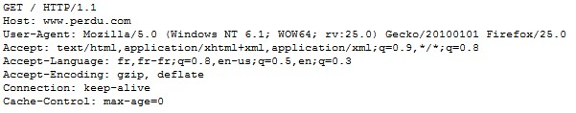
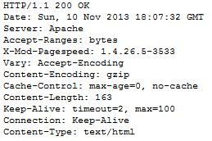
HTTP(cont.)
●
Conversation sample
●
client request
●
server response

Slide 13
HTTP(cont.)
GET : requests a resource
HEAD : like GET request but without the response body
POST : requests that the server accept the entity enclose in the request
●
Request methods
●
●
●
–
might be a form
PUT : requests that the enclose entity be store DELETE : deletes the resource
●
●

Slide 14
Java evolution
●
Language issued from a Sun project
●
1990
named “Stealth” and supervised by Patrick Naugthon James Gosling and Mike Sheridan arrived in 1994
●
●
●
1996 : first JDK publication
–
JDK : Java Development Kit
●
2009 : Oracle bought Sun
2010 : James Gosling quits Oracle
●

Slide 15
Java evolution(cont.)
●
JDK 1.0 – 1996 (23 of January) : 201 classes et 8 packages
JDK 1.1 – 1997 (19 of February) : 503 classes et 23 packages
J2SE 1.2 – 1998 (9 of December) : 1 520 classes et 59 packages
J2SE 1.3 – 2000 (8 of May) : 1 840 classes et 76 packages
J2SE 1.4 – 2002 (6 of February) : 2 990 classes et 135 packages
J2SE 5.0 – 2004 (30 of September) : 3 280 classes et 166 packages
Java SE 6 – 2006 (11 of December) : 3780 classes et 202 packages
Java SE 7 – 2011 (7 of July) : 4 024 classes et 209 packages
Java SE 8 – 2014
Java SE 9 - 2016
●
●
●
●
●
●
●
●
●

Slide 16
Java acronyms
●
JRE : Java Runtime Environment JDK : Java Development Kit JVM : Java Virtual Machine Java SE : Java Standard Edition
●
●
●
●
earlier J2SE
●
Java ME : Java Micro Edition
●
earlier J2ME
●
Java EE : Enterprise Edition
●
earlier J2EE

Slide 17
Java acronyms(cont.)
●
JSR : Java Specification Request
●
users can ask new features in the Java platforms
●
JCP : Java Community Process
●
consortium which manage the Java evolutions
●
EJB : Enterprise Java Bean
●
JavaBean component handles by a Java EE server
●
POJO : Plain Old Java Object
●
a very simple Java component

Slide 18
Java platforms
●
Java SE
●
standalone applications
executed when launching the JVM
●
–
java tool
●
Java EE
●
the application is handled in a server
●
Java ME
●
embedded applications
executed in a particular JVM : the KVM
●

Slide 19
Development cycle
●
Simple view of development cycle
source Java code file Test.java
compilation with javac tool
Java bytecode Test.class
execution in the JVM java tool

Slide 20
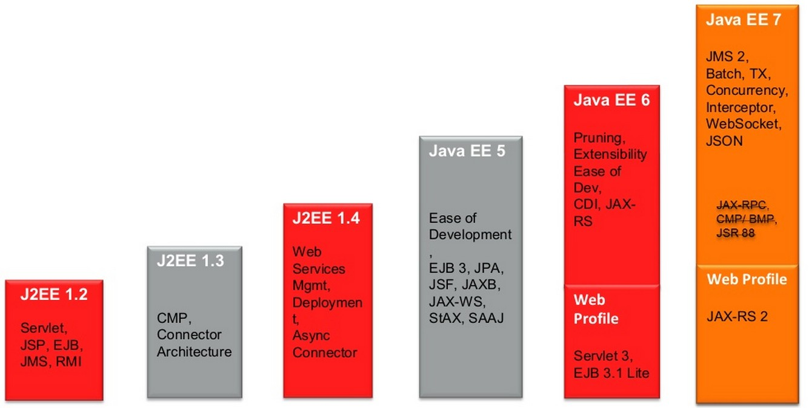
Java EE overview

Slide 21
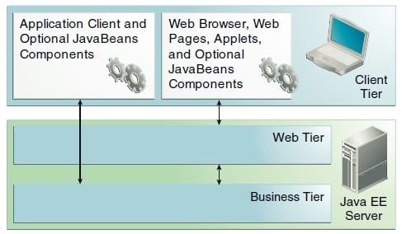
Java EE overview(cont.)
●
Java EE defines
●
an architecture for implementing services as multitier applications
–
–
–
scalability accessibility manageability
source : Oracle

Slide 22
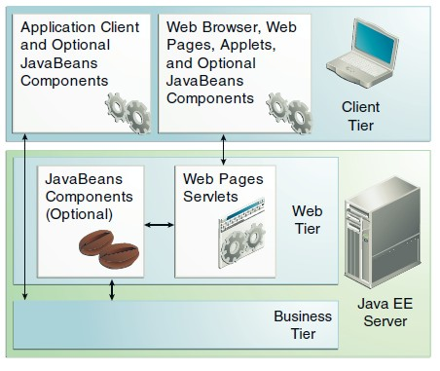
Java EE overview(cont.)
●
Web components
●
JSP and servlets
source : Oracle

Slide 23
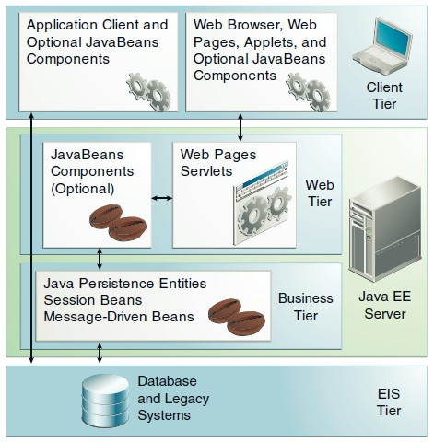
Java EE overview(cont.)
●
Business components
Enterprise Information System
source : Oracle

Slide 24
Java EE overview(cont.)
●
Java EE containers
●
container services, provides :
–
JNDI – Java Naming and Directory Interface
●
the application components can access the services by their names
–
Java EE security model
configures a web component or EJB so that resources are accessed only by authorized users
Java EE transaction
●
–
specifies relationships among methods that make up a single transaction so that all methods in one transaction are treated as a single unit
JMS, Java EE remote connectivity, mail, data sources, ...
●
–

Slide 25
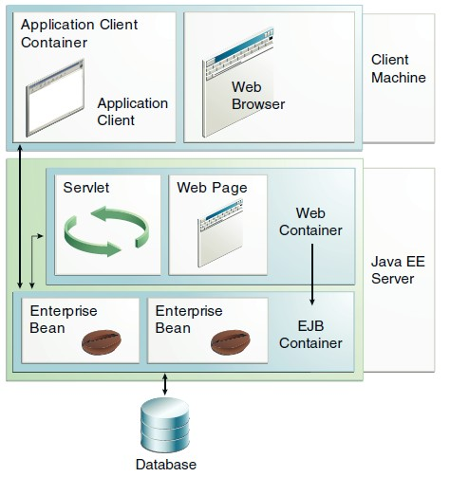
Java EE overview(cont.)
●
Container types
source : Oracle

Slide 26
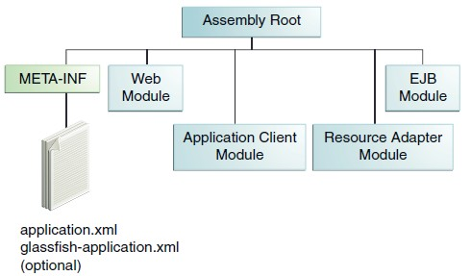
Java EE overview(cont.)
●
Packaging application
●
application is delivered in a Java Archive (JAR) file
–
–
WAR : Web Archive EAR : Enterprise Archive
●
contains Java EE modules
source : Oracle

Slide 27
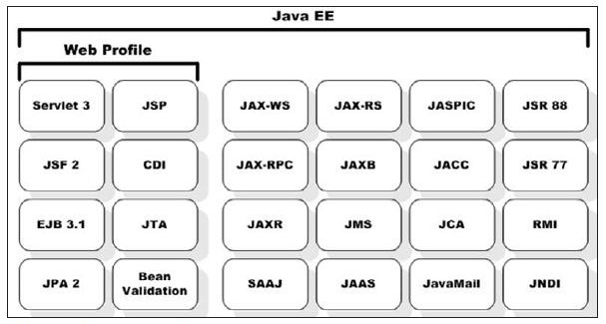
Java EE overview(cont.)
●
Profiles
●
configurations of the Java EE platform targeted at specific classes of applications
–
–
Web Profile Full Profile

Slide 28
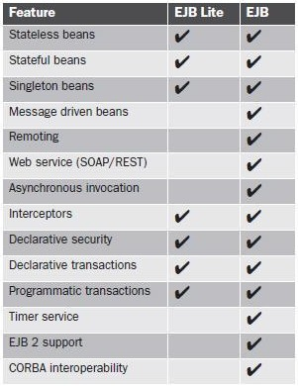
Java EE overview(cont.)
●
Web Profile includes EJB Lite
●
not the full EJB API

Slide 29
Tomcat Overview
 | Tomcat 4 | Tomcat 5 | Tomcat 6 | Tomcat 7 | Tomcat 8
Servlet | 2.3 | 2.4 | 2.5 | 3.0 | 3.1
JSP | 1.2 | 2.0 | 2.1 | 2.2 | 2.3
EL | N/A | (2.0) | 2.1 | 2.2 | 2.4
Java | 1.3 | 1.4 | 1.5 | 1.6 | 1.7

Slide 30
Architecture of Tomcat
Server
Service
Connector HTTP
Engine
port 8080
Connector HTTPS
Host
port 8443
Context
Context
Connector AJP
port 8009

Slide 31
Architecture of Tomcat
●
Tomcat instance is the top-level component
●
only one instance per JVM
–
multiple instances can run on separate JVM and network ports
●
server.xml provides an XML representation of relationships between the different containers
<Server>
<Service>
<Connector />
<Engine>
<Host>
<Context></Context>
</Host>
</Engine>
</Service>
</Server>

Slide 32
Architecture of Tomcat
●
<Server> represents the entire Catalina server engine
●
Catalina is the Java servlet container implementation may contain one or more <Service> containers
●
●
<Service> holds a collection of <Connector>
●
connectors share one <Engine>
●
<Connector> defines the port for handling request and response

Slide 33
Architecture of Tomcat
<Engine> handles all requests received by the connectors
<Host> defines virtual hosts
●
●
●
the virtual hosts are contained in an instance of engine each host can be a parent to one or more <Context>
component
●
●
<Context> represents a web application

Slide 34
Architecture of Tomcat
●
Tomcat is not
●
a Web Profile server a httpd server
●
–
Apache httpd is better
●
Tomcat is
●
just a Java EE web container
●
Tomcat is part of many projects
●
Jboss
TomEE
...
●
●

Slide 35
Dockers…☺
https://www.docker.com/tryit
version 1.0

Slide 36
Installation
Java – Tomcat – Apache httpd
version 1.0

Slide 37
Installing Java
●
Installing Java on CentOS 7
●
download Sun/Oracle Java JDK
–
http://www.oracle.com/technetwork/java/javase/downloads/jdk7-downloads-1880260.html
select rpm
–
●
in the Terminal
–
change to root user
●
su - or
sudo -i
–
install Java JDK package
●
rpm -Uvh /path/to/binary/jdk-7u71-linux-x64.rpm
–
verify the installation
●
java -version

Slide 38
Installing Java (cont.)
●
Installing Java on CentOS 7
●
setup JAVA_HOME
–
add JAVA_HOME in /etc/profile
export JAVA_HOME="/usr/java/latest"
–
Reboot/relogin and verify
echo $JAVA_HOME

Slide 39
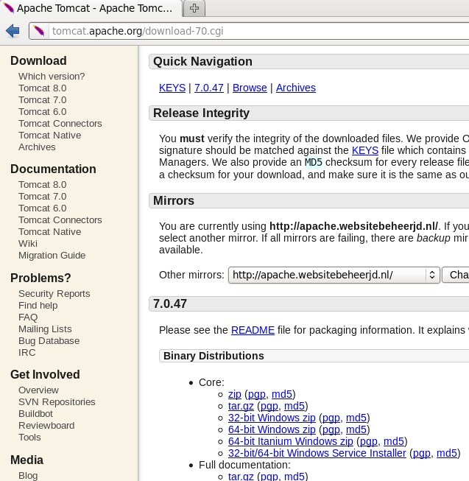
Installing Tomcat 7(cont.)
●
Download Tomcat distribution
●
http://tomcat.apache.org/download-70.cgi download the code distribution
●

Slide 40
Installing Tomcat 7(cont.)
●
Setup CATALINA_HOME
●
add CATALINA_HOME in /etc/profile
–
you need to be root
export CATALINA_HOME="/opt/tomcat7"
●
perhaps you need to change the tomcat folder owner
– chown -R franck apache-tomcat-7.0.47/

Slide 41
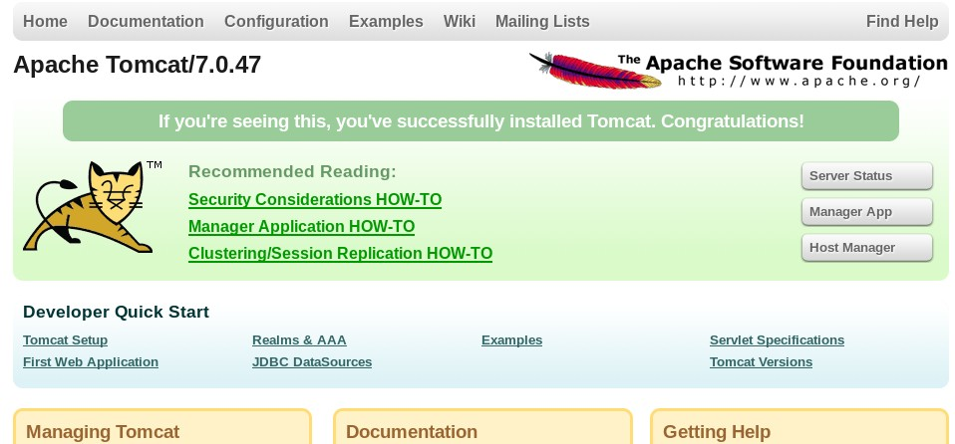
Installing Tomcat 7(cont.)
●
Starting Tomcat
cd /opt/apache-tomcat-7.0.47/bin/
./startup.sh
●
verifying the good installation
●
open localhost:8080

Slide 42
Installing Tomcat 7(cont.)
●
Stopping Tomcat 7
cd /opt/tomcat7/bin/
./shutdown.sh
telnet localhost 8005
>SHUTDOWN

Slide 43
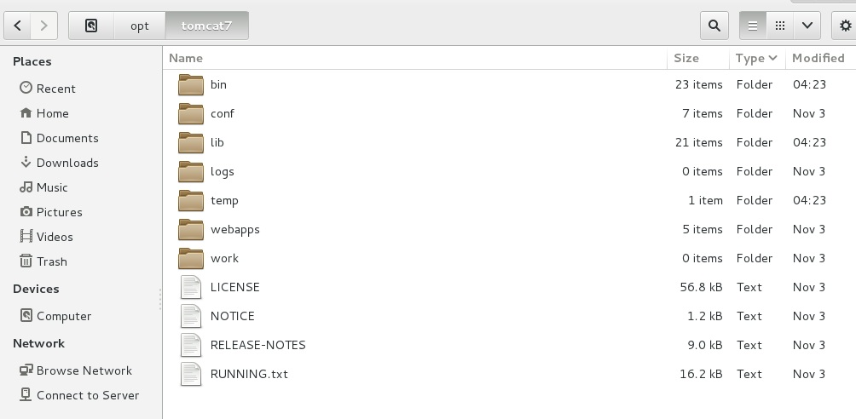
Tomcat directories

Slide 44
Tomcat directories(cont.)
bin : contains the scripts for starting and stopping Tomcat
conf : contains the configuration files
●
●
●
server.xml : general server configuration file
web.xml, context.xml : global web application configuration files
tomcat-user.xml : default user list for file-based authentication
●
●

Slide 45
Tomcat directories(cont.)
lib : contains jar files used by Tomcat
logs : contains server logs
webapps : contains web applications
●
●
●
●
contains some default web applications
–
includes Tomcat manager application
●
deployment directory
●
temp : contains temporary files
work : contains compiled JSP pages
●

Slide 46
Installing Apache httpd
●
Apache httpd server is installed with CentOS by default
●
if you need to install Apache httpd
yum install httpd
●
Starting Apache httpd
●
in root mode
/etc/init.d/httpd start
or
apachectl start

Slide 47
Installing Apache httpd(cont.)
●
Stopping Apache httpd
●
as root user
/etc/init.d/httpd stop
or
apachectl stop
●
Setting the Apache service to start on boot
●
as root user
chkconfig --levels 235 httpd on

Slide 48
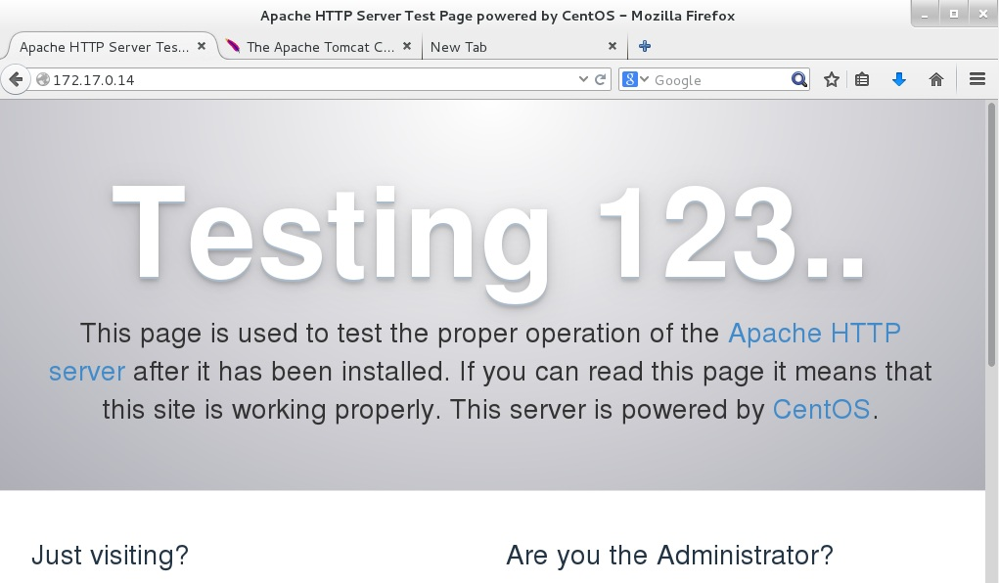
Installing Apache httpd(cont.)
●
Testing Apache httpd

Slide 49
Tomcat architecture and configuration
version 1.0

Slide 50
Servlet 3.0 – Asynchronous processing
Prior to Servlet 3.0 request/response processing was synchronous
Response processing can now be asynchronous
Requests are still synchronous
More efficient use of Threads
All Filters and Servlets in the processing chain must support Async
Typical uses
Accessing external resources
Web services
Databases
Regular updates to users
Stock ticker
Progress indicator

Slide 51
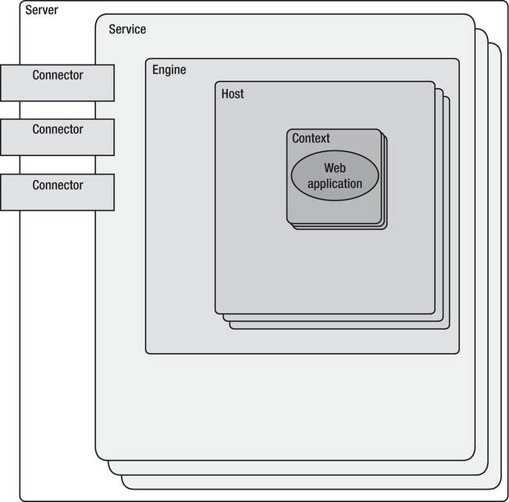
Architecture overview
●
Tomcat consists of a nested hierarchy of components

Slide 52
Architecture overview(cont.)
●
Server
●
the server is Tomcat itself
–
it owns a port used for shut down the server
<Server port="8005" shutdown="SHUTDOWN">
●
only one instance by JVM
–
separate servers can be set up on the same machine
●
separate JVM and servers configured with different ports could be secure web application
●
–
one web application per server
●
if the JVM crashes, only one application is affected

Slide 53
Architecture overview(cont.)
●
Service
●
contains a single container Engine contains one or more Connectors
the service is named for easily identify log messages
●
●
●
Connectors
●
they connect the applications to clients
they represent the point at which request are received they are assigned a port on the server
Coyote : default connector for HTTP/1.1
●
●
●

Slide 54
Architecture overview(cont.)
it is a request-processing component thats represents the Catalina Servlet engine
it examines th HTTP headers to determine the context to which request should be passed
●
Engine
●
●
●
Realm
●
manages user authentication and authorization
by default a user must still authenticate separately to each web application
●
–
we will see how this can be change, using sing sign-on

Slide 55
Architecture overview(cont.)
●
Valves
●
enable Tomcat to intercept a request and preprocess
–
like filter of Servlet Specification but they are specific to Tomcat
●
Hosts, Contexts and Engines may contains Valves they are commonly used to
●
–
–
enable SSO log requests
●
a Valve is a reusable component which could be add or remove
–
inclusion is transparent to web application

Slide 56
Architecture overview(cont.)
●
Loggers
●
report on the internal state of a component
●
Host
●
Engine may contains one or more Host
–
–
one default host
zero or more virtual hosts
●
in Tomcat virtual hosts are differentiates by a fully qualified hots name
–
www.example.com and www.example.net can both reside in the same server

Slide 57
Architecture overview(cont.)
●
Context
●
this is the web application
–
it becomes parent of servelts and filters
●
as StandardWrapper objects
●
a web application could include
–
–
a web.xml
a context.xml
●
supports dynamic reload
–
classes that have been changed are reloaded into memory
●
may include specific error pages

Slide 58
Files in $CATALINA_HOME/conf
●
server.xml
●
main configuration file
Tomcat reads this file at startup
●
components configured in this file affect the entire Tomcat instance
application-level context should not be made in this file
–
●
–
use a per-application context.xml
●
tomcat-user.xml
●
contains user authentication and role-mapping

Slide 59
Files in $CATALINA_HOME/conf(cont.)
●
context.xml
●
default application context for any web applications
could be contains components for all the web applications deployed in Tomcat
●
–
–
–
JDBC DataSource connection realm
etc.
●
application can customized and override this file with their own context.xml file

Slide 60
Files in $CATALINA_HOME/conf(cont.)
●
web.xml
●
default deployment descriptor for all web applications provides basic servlet definition and MIME mappings applications usually have their own web.xml
●
●
●
catalina.policy
●
Java SE security model
–
controls the permission to access resources
●
default policy file for running Tomcat in secured mode

Slide 61
Files in $CATALINA_HOME/conf(cont.)
●
catalina.properties
●
this file is read at startup
provides for internal packages access and definition control
●
●
logging.properties
●
configuration file for logging
–
Tomcat uses its own implementation of Java Logging

Slide 62
<Server> component
●
in server.xml
key attributes
●
●
port : TCP port to listen for the command specified by the shutdown attribute
shutdown : command text string used for shutting down
●
–
can be telnet to the port 8005 with SHUTDONW to take the server down
●
cannot be done remotely for security reasons

Slide 63
<Service> component
●
key attributes
●
className : classe name for the service
–
org.apache.catalina.core.StandardService by default
●
name : name for the service
–
used in logging, administration, management
●
key elements
●
<Connector> : one or more
–
component that handles external client connections
●
<Engine> : request-processing component (Catalina)

Slide 64
Web application configuration
●
A web application consist of
●
static content
–
HTML pages, image files, PDF files, …
●
dynamic content
–
servlets, JSP, Java classes
●
Web applications are usually installed under the
webapps directory
●
deployed in a directory named after the web application
–
this name is also used in the web application URL

Slide 65
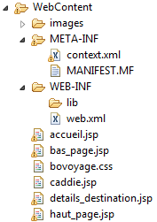
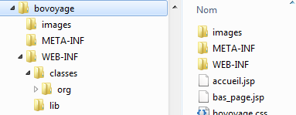

Web application configuration(cont.)
●
Web application structure
developer's project
war file

Slide 66
Web application configuration(cont.)
●
URL parsing
Coyote connector
/conf/server.xml
Virtual host name
/conf/server.xml
http://www.example.com/bovoyage/addCaddy/5
context path
processed by servlet
servlet mapping
/WEB-INF/web.xml

Slide 67
Web application configuration(cont.)
●
ROOT web application
●
installed under /webapps
default web application
●
–
no context path needs to be specified
●
http://localhost:8080/

Slide 68
Web application configuration(cont.)
●
META-INF directory contains optional files
●
context.xml file contains the specific configuration for the web application
MANIFEST.MF file
●
–
version, vendor, …

Slide 69
Deployment descriptor web.xml
●
Application-specific deployement file key elements
●
●
<context-param> : mechanism used for setting application-initialization parameters
–
contains <param-name> , <param-value>
●
<filter> : reusable component that intercept the client request and response and apply some type of processing
–
–
compression, …
contains <filter-name>, <filter-class>

Slide 70
Deployment descriptor web.xml(cont)
●
key elements
●
<listener> : component design to respond to event in an application
–
session start and stop, application start and stop, …
●
<servlet> : a servlet is declared by assigning it a unique name which references its fully qualified class name
<servlet>
<servlet-name>controleur</servlet-name>
<servlet-class>org.bovoyage.servlet.ControleurServlet</servlet-class>
</servlet>

Slide 71
Deployment descriptor web.xml(cont)
●
key elements
●
<servlet-mapping> : specifies the mapping between a servlet and a URL pattern
<servlet-mapping>
<servlet-name>controleur</servlet-name>
<url-pattern>/controleur</url-pattern>
</servlet-mapping>
<servlet-mapping>
<servlet-name>controleur</servlet-name>
<url-pattern>/index.jsp</url-pattern>
</servlet-mapping>

Slide 72
Deployment descriptor web.xml(cont)
●
key elements
●
<session-config> and <session-timeout>
–
used to set a session timeout value (mn)
●
<welcome-file-list> : defines the default resource, il no resource is specified in the URL
–
for example http://localhost:8080/bovoyage request the index.jsp
resource
<welcome-file-list>
<welcome-file>index.jsp</welcome-file>
</welcome-file-list>

Slide 73
Deployment descriptor web.xml(cont)
●
key elements
●
<error-page> : error pages configuration
–
the cause may be a HTTP error or a Java exception
<error-page>
<error-code>404</error-code>
<location>/errors/oops.jsp</location>
</error-page>
<error-page>
<error-code>java.lang.NullPointerException</error-code>
<location>/errors/appProblem.jsp</location>
</error-page>

Slide 74
Deployment descriptor web.xml(cont)
●
key elements
●
<security-constraint>
<security-role>
<login-config>
●
●
–
these elements relate to the configuration of login authentication in the application
we shall see in detail later
–

Slide 75
Deployment descriptor web.xml(cont)
●
key elements
●
<resource-ref>
<resource-env-ref>
<env-entry>
●
●
–
are provided for configuring resources for the web application
●
a database-connection pooling, ...

Slide 76
Tomcat manager application
●
manager application is a web application
●
three way to interact with the manager application
–
–
using the web interface using HTTP requests
●
via the browser via scripts
●
–
using Ant-based interface
●
Access to the manager application is restricted to authorized users

Slide 77
Tomcat manager application(cont.)
●
Summary of some tasks that the manager application can perform
●
deploy a new web application manage th currently web applications list the available global JNDI resources list the available security roles
display session statistics
●
●
●
●

Slide 78
Tomcat manager application(cont.)
●
Enabling access to the manager application
●
this example use the User Database Realm
–
–
but any realm implementation can be used
the username, password and roles are initialized at startup from the conf/tomcat-users.xml configuration file
●
this file needs to be edited to add a user with a role manager-gui
Tomcat need to be restarted
●
<tomcat-users>
<role rolename="manager-gui"/>
<user username="admin" password="adminpw" roles="manager-gui"/>
</tomcat-users>

Slide 79
Tomcat manager application(cont.)
●
Using HTTP requests
●
URL format :
http://[hostname]:[port]/manager/text/command?parameters
commands
●
–
list, sessions, start, stop, install, remove, deploy, undeploy, reload, serverinfo, roles, resources
the list depends of the Tomcat version – see documentation
–
●
parameters
–
–
–
file:/absolute/path/to/a/directory file:/absolute/path/to/a/webapp.war jar:file:/absolute/path/to/a/webapp.war!

Slide 80
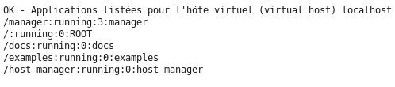
Tomcat manager application(cont.)
●
Using HTTP request
●
needed to add the role manager-script
<role rolename="manager-gui"/>
<role rolename="manager-script"/>
<user username="admin" password="adminpw" roles="manager-gui,manager-script"/>
●
example :
–
http://localhost:8080/manager/text/list

Slide 81
Servlet and JSP
version 1.1

Slide 82
Servlet
●
Platform-independent web application component
●
communicate with web client using request/response
●
The developer extends the HttpServlet class
●
javax.servlet and javax.servlet.http
public class HelloServlet extends HttpServlet {
public void init(ServletConfig config) throws ServletException {
}
public void destroy() {
}
protected void doGet(HttpServletRequest request, HttpServletResponse response)
throws ServletException, IOException {
}
protected void doPost(HttpServletRequest request, HttpServletResponse response)
throws ServletException, IOException {
}
}

Slide 83
Servlet(cont.)
●
The servlet is declared in the web.xml
●
the developer compiles the servlet and deploys it in the
WEB-INF/classes directory
<servlet>
<servlet-name>HelloServlet</servlet-name>
<servlet-class>org.bovoyage.servlet.HelloServlet</servlet-class>
</servlet>
<servlet-mapping>
<servlet-name>HelloServlet</servlet-name>
<url-pattern>/hello</url-pattern>
</servlet-mapping>

Slide 84
Servlet(cont.)
●
Life-cycle
class
no
HTTP request
loaded
the servlet is instantiate
yes
yes
class changed
destroy()
no
service()
the servlet is unloaded
init()

Slide 85
Servlet(cont.)
●
Servlet API 3.0 allows us to configure the servlet details using annotations, instead XML
@WebServlet(
name="HelloServlet", urlPatterns="/hello")
public class HelloServlet extends HttpServlet{
...
}

Slide 86
JSP
●
Java Server Page
●
Simple technology
<html>
<head>
<meta http-equiv="Content-Type" content="text/html; charset=UTF-8">
<title>Hello JSP</title>
</head>
<body>
<h2>Hello, world</h2>
</body>
</html>

Slide 87
JSP(cont.)
●
Life-cycle
●
translation
–
the JSP file is translated to Java servlet source
●
compilation
–
the generated servlet class is compiled
●
loading
–
the compiled servlet is loaded in memory
●
instantiation initialization servicing request destruction
●
●
●

Slide 88
JSP(cont.)
●
Life-cycle
class loaded
no
request
yes
JSP
changed
yes
instance is unloaded
translation
no
jspService()
response
jspInit()
the class is instantiate

Slide 89
Components of a JSP
●
Page directive
●
provide global information about a JSP page
<%@ page language="java" contentType="text/html; charset=UTF-8" pageEncoding="UTF-8"%>
●
Include directive
●
to insert file (text or JSP) at translation time
<%@ include file="header.jsp" %>
●
Taglib directive
●
to use a custom tag library
<%@ taglib uri="http://java.sun.com/jsp/jstl/core" prefix="c" %>

Slide 90
Components of a JSP
●
Declarations
●
used to define Java variables and methods in the JSP page
<%! String name="toto"; %>
<%! String getHello(){ return "Hello";} %>
●
Expressions
●
the expression is replaced with the resulting value of the container evaluation
<%= getHello() %> <%= name %>

Slide 91
JSP Expression Language (EL)
●
EL is a powerful feature introduced with the version 2.0
●
it enable developers to easily access Java objects
destinations is collection of POJO
...
<table>
<c:forEach items="${destinations}" var="destination">
<tr>
<td>${destination.region }</td>
<td><a href='controleur?cde=det&id=${destination.id }'>détails</a></td>
</tr>
</c:forEach>
</table>
...
destination is a POJO

Slide 92
Tomcat valves and filters
version 1.1

Slide 93
Valves and Filters
●
The purpose of theses components is intercepting requests for one or more web application
Valve is a proprietary Tomcat technology Filter is a server-independent technology
We need a mechanism to preprocess request before it reaches the web application
●
●
●
●
login about requests
allowing access from certain remote IPs data compression
●
●

Slide 94
Valves and Filters(cont.)
●
Theses requirements are independent of applications Tomcat Valves vs. Servlet Filters
●
●
Filter is a servlet specification
–
–
–
it is platform-independent
filter-chaining functionality is very useful
it can only be configured on a web application level
●
Valve can be better performing and robust
–
–
because Valve is part of the Tomcat engine API it can be configured on the engine or host level

Slide 95
Valves and Filters(cont.)
●
Adding the valve to Tomcat
●
package the valve in a jar file
copy the jar file in <TOMCAT_HOME>/lib
●
●
Configure the valve to be executed for all requests
●
modify the conf/server.xml
–
in the <Host> element
<Valve className="org.antislashn.tomcat.valves.SimpleLoggingValve" />

Slide 96
AccessLog Valve
●
Tomcat prepackaged Valve
It creates log files to track client access information
●
●
can be associated with Engin, Host or Context its configuration is in server.xml file
●
<Valve className="org.apache.catalina.valves.AccessLogValve" directory="logs" pattern="%h %l %u %t &quot;%r&quot; %s %b" prefix="localhost_access_log."
suffix=".txt"/>

Slide 97
Remote Access Valve
●
Allow you to compare th IP address of the requesting client against one or more regular expression
●
allow or prevent the request from continuing
–
two attributes
●
access
deny – a HTTP status code 403
●
<Valve className="org.apache.catalina.valves.RemoteAddrValve" deny="127.*"/>

Slide 98
Crawler Session Manager Valve
crawler or spiders
when hundred of separate crawler processes access the web site, a user session will be created for each of them
this valve ensures that each unique web crawler is associated with on user session
●
Search engines employ special programs to discover and index the web sites
●
●
●
<Valve className="org.apache.catalina.valves.CrawlerSessionManagerValve" crawlerUserAgents="[bB]ot.*|*Yahoo! Slurp.*|.*Feedfetcher-Google.*." sessionInactiveInterval="3600" />

Slide 99
Dead Thread Detection Valve
●
Each request from a single user is processed by a separate Java thread
●
sometimes these threads get stuck
–
–
network problems bugs
●
this valve helps to detect the stuck threads
–
threshold attribute
<Valve className="org.apache.catalina.valves.DeadThreadDetectionValve" threshold="300" />

Slide 100
Servlet Filters
●
Interface javax.servlet.Filter
●
methods
–
init(FilterConfig)
●
initialize the filter – it is called once
–
doFilter(ServletRequest, ServletResponse, FilterChain)
●
this method is executed for every request must call filterChain.doFilter(...)
●
–
destroy()
●
call once, when the web application is undeployed

Slide 101
Servlet Filters(cont.)
●
Implementing a Filter
public class TimeFilter implements Filter {
private FilterConfig config = null;
public void destroy() { config = null;
}
public void doFilter(ServletRequest request, ServletResponse response,
FilterChain chain) throws IOException, ServletException {
long debut = System.currentTimeMillis(); config.getServletContext().log(">>> avant appel servlet"); chain.doFilter(request, response);
long fin = System.currentTimeMillis(); config.getServletContext().log(">>> après appel servlet");
config.getServletContext().log(">>> TEMPS : " + (fin-debut) + " ms");
}
public void init(FilterConfig fConfig) throws ServletException { config = fConfig;
}
}

Slide 102
Servlet Filters(cont.)
●
Filter configuration
●
in the WEB-INF/web.xml
<filter>
<display-name>TimeFilter</display-name>
<filter-name>TimeFilter</filter-name>
<filter-class>org.antislashn.web.TimeFilter</filter-class>
</filter>
<filter-mapping>
<filter-name>TimeFilter</filter-name>
<url-pattern>/test</url-pattern>
<dispatcher>REQUEST</dispatcher>
</filter-mapping>

Slide 103
Servlet Filters(cont.)
REQUEST : only when the request comes directly from the client
FORWARD : only when the request has been forwarded to a component
INCLUDE : only when the request is being processed by a included component
ERROR : only when the request is being processed with the error page mechanism
●
Filter configuration
●
<dispatcher> selects one of the following dispatcher types :
–
–
–
–

Slide 104
Request Dumper Filter
●
This built in filter dumps the entire
HttpServletRequest to the Tomcat log
<filter>
<filter-name>DumperFilter</filter-name>
<filter-class>org.apache.catalina.filters.RequestDumper</filter-class>
</filter>
<filter-mapping>
<filter-name>DumperFilter</filter-name>
<url-pattern>/*.jsp</url-pattern>
</filter-mapping>

Slide 105
Expires Filter
●
It controls the HTTP expires header
<filter>
<filter-name>ExpiresFilter</filter-name>
<filter-class>org.apache.catalina.filters.ExpiresFilter</filter-class>
<init-param>
<param-name>ExpiresByType image</param-name>
<param-value>access plus 10 minutes</param-value>
</init-param>
<init-param>
<param-name>ExpiresByType text/css</param-name>
<param-value>access plus 10 minutes</param-value>
</init-param>
<init-param>
<param-name>ExpiresByType application/javascript</param-name>
<param-value>access plus 10 minutes</param-value>
</init-param>
</filter>
<filter-mapping>
<filter-name>ExpiresFilter</filter-name>
<url-pattern>/*</url-pattern>
<dispatcher>REQUEST</dispatcher>
</filter-mapping>

Slide 106
JMX
Java Management eXtension
version 1.1

Slide 107
JMX overview
●
Java Management eXtension
●
specification add in Java 5
used to manage servers, applications, JVM
●
●
JMX architecture
●
three levels
–
instrumentation
●
MBean probe object
–
–
agent
distributed services

Slide 108
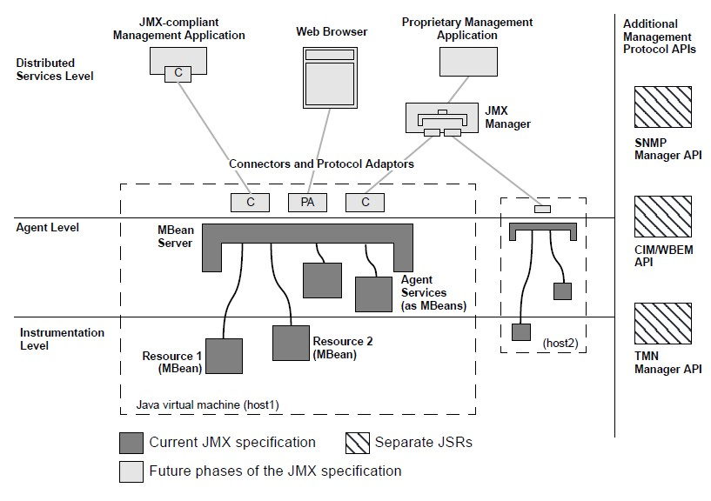
JMX overview(cont.)

Slide 109
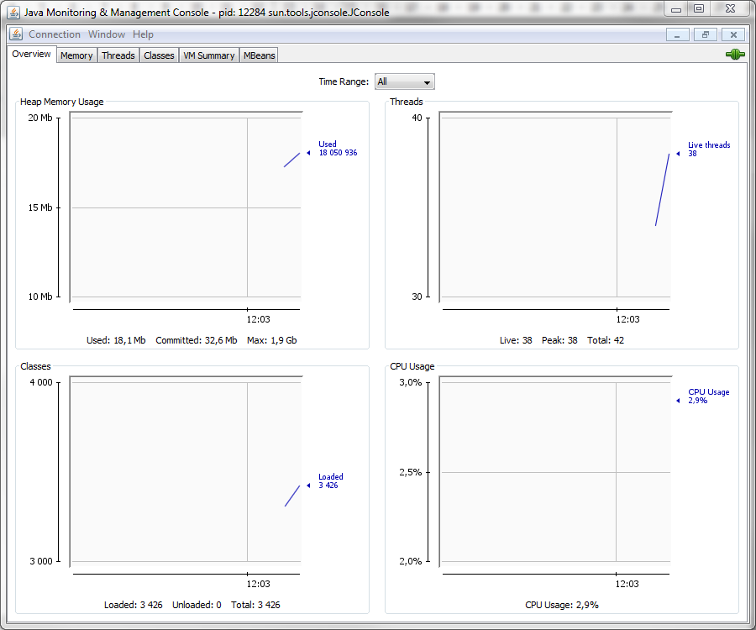
JMX overview(cont.)
client level
JMX client
Connectors and adapters
JMX agent
Services :
●Timers
●Notification
MBean server
instrumentation
MBean
MBean
MBean

Slide 110
JMX overview(cont.)
●
MBeans are software modules
●
expose the capabilities of a hardware device or software component
different types of MBean
●
–
Standard MBean
●
only this one will be discussed here
–
–
–
–
Dynamic MBean Model MBean Open MBean MXBean

Slide 111
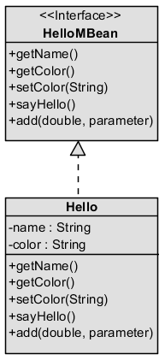
JMX – Standard Mbean(cont.)
●
Simple
●
an Java interface
–
same name than implementation class suffixed with MBean
getter → read property setter → write property
–
–
●
an Java implementation class

Slide 112
JMX – Standard Mbean(cont.)
●
The MBean is identified by its unique name
●
ObjectName class two parts
●
–
–
–
domain properties
both separate by a colon character
jboss.deployment:flavor=URL,type=DeploymentScanner

Slide 113
JMX – Standard Mbean(cont.)
●
Java interface
public interface HelloMBean {
// properties String getName(); String getColor();
void setColor(String color);
// operations
void sayHello();
double add(double a, double b);
}

Slide 114
JMX – Standard Mbean(cont.)
●
Java implementation class
public class Hello implements HelloMBean { private String name ="Toto Standard MBean"; private String color = "vert";
@Override public String getName() {
return name;
}
@Override public String getColor() {
return color;
}
@Override public void setColor(String color) {
this.color = color;
}
@Override public void sayHello() {
System.out.println(">>> Standard MBean "+name+" - "+color);
}
@Override public double add(double a, double b) {
return a+b;
}
}

Slide 115
JMX – Standard Mbean(cont.)
●
Agent level - main steps
●
recovering a MBean server
MBeanServer mbs = ManagementFactory.getPlatformMBeanServercreating();
●
instantiating an ObejctName
ObjectName mBeanName = new ObjectName("antislashn.jmx:bean=Hello,type=standard");
●
recording the MBean in the server
HelloMBean mBean = new Hello(); mbs.registerMBean(mBean, mBeanName);

Slide 116
JMX – Standard Mbean(cont.)
●
For securing reasons, we need to activate the JMX access
●
-Dcom.sun.management.jmxremote other properties could be defined
●
–
–
mandatory if remote JMX access
see the password template file in <JRE_HOME>/lib/management
java -Dcom.sun.management.jmxremote.port=3333
-Dcom.sun.management.jmxremote.ssl=false
-Dcom.sun.management.jmxremote.authenticate=false MonAppliJava

Slide 117
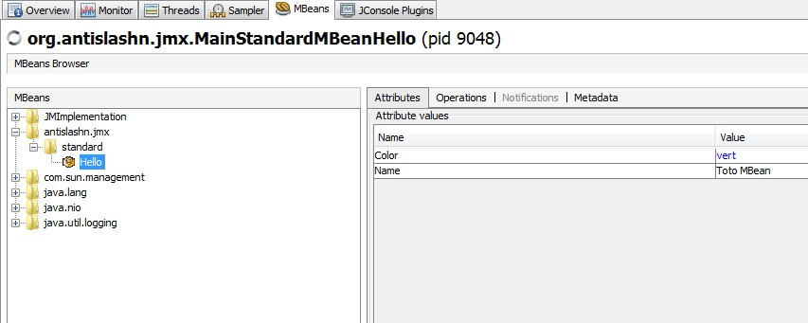
JMX – Standard Mbean(cont.)
●
We can now use jconsole or jvisualvm

Slide 118
Tomcat and JMX
●
Working with the JMX proxy
●
add the role manager-jmx
the URL for accessing the JMX proxy is as follow
●
–
–
http://<host>:<port>/manager/jmxproxy/<operation details> example
●
http://localhost:8080/manager/jmxproxy/list

Slide 119
Tomcat and JMX(cont.)
●
Using jconsole to monitor Tomcat
●
we must enable the JMX support inside Tomcat
–
add a file called
●
setenv.sh
–
with the following line
set CATALINA_OPTS=-Dcom.sun.management.jmxremote
●
restart Tomcat

Slide 120
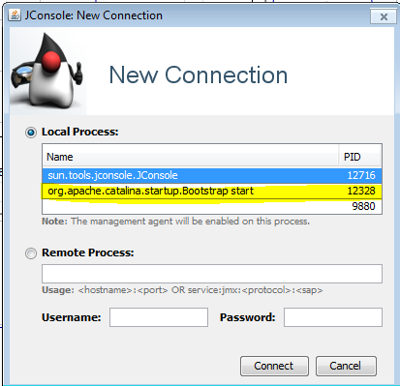
Tomcat and JMX(cont.)
●
Start jconsole

Slide 121
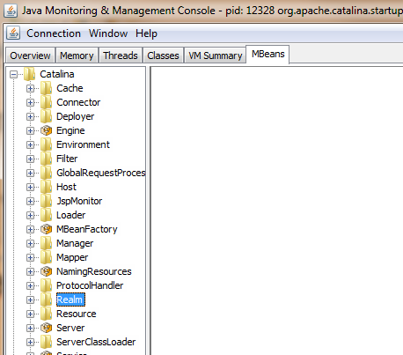
Tomcat and JMX(cont.)
●
Go to the mbeans tab

Slide 122
Tomcat logging

Slide 123
Java Logging Framework
●
Since Java 1.4, Java itself comes with the capable logging package java.util.logging
Since Tomcat 6, Tomcat itself uses Java Logging instead Commons Logging API
●
●
Tomcat 6 has done away with the <Logger> element
–
use the conf/logging.properties file
●
Tomcat developers extend the functionality of the standard Java logging framework
●
this implementation is known as JULI
–
Java Util Logging Interface

Slide 124
Java Logging overview
●
To instantiate a logger instance in th Java code, you will use static factory method, and construct a logger with the selected name
Logger log = Logger.getLogger("org.antislashn");
●
Each logger accept messages with different logging level
●
based on their importance
log.severe("Message niveau severe"); log.info("Message niveau info"); log.finest("Message niveau finest");

Slide 125
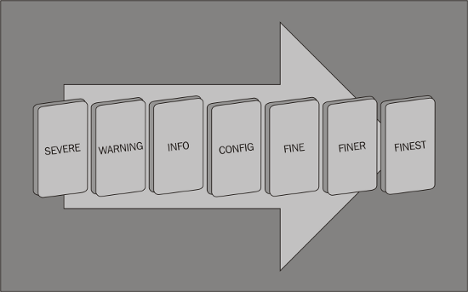
Java Logging overview(cont.)

Slide 126
Java Logging overview(cont.)
●
Logging levels
●
SEVERE : used to log exceptions, errors, ... WARNING : used to log warning messages INFO : used to log information messages
CONFIG : used to log configuration messages, initializations, ...
FINE : used to log detailed information, useful for debugging purposes
FINER : more information than FINE FINEST : logs all messages
●
●
●
●
●
●

Slide 127
Java Logging overview(cont.)
●
Handlers
●
each logger has a list of handlers associated with it
represented by an abstract class
java.util.logging.Handler
three main handlers are available
–
●
–
ConsoleHandler : outputs the logged messages to
System.err
FileHandler : writes the messages to a file
–
●
supporting file rotation
–
SocketHandler : writes messages to the network socket

Slide 128
Java Logging overview(cont.)
●
Formatter
●
JULI adds three formatters
–
OneLineFormatter : same format as SimpleFormatter, but written in a single line
VerbatimFormatter : writes the log message only, without any additional information
JdkLoggerFormatter : uses a compact output format with timestamps
–
–

Slide 129
Java Logging overview(cont.)
application
Logger
Handler
out
Formatter

Slide 130
Java Logging overview(cont.)
●
Logging configuration
●
typically specified int the file logging.properties
handlers= java.util.logging.ConsoleHandler java.util.logging.ConsoleHandler.level = ALL java.util.logging.ConsoleHandler.formatter = java.util.logging.XMLFormatter
–
#1 : defines all handlers (comma separator)
●
handler is specified by his class name there is only one instance by JVM
●
–
–
#2 : default logging level for this handler
#3 : formatter for this handler

Slide 131
JULI configuration
Java Logging Framework guarantees than only one handler is instantiated by JVM
JULI supports one handler per class loader
●
●
●
a prefix is add to each handler type
–
–
–
starts with a number and an arbitrary string
and ends with a period "."
handlers = 1catalina.org.apache.juli.FileHandler, 2localhost.org.apache.juli.FileHandler

Slide 132
JULI configuration(cont.)
●
The defaults handlers are defined with the
.handlers property
●
will be used for loggers that do not have a specific handler configured
.handlers = 1catalina.org.apache.juli.FileHandler, java.util.logging.ConsoleHandler
●
Each handler is configured
●
name of the handler followed by the property
1catalina.org.apache.juli.FileHandler.level = FINE 1catalina.org.apache.juli.FileHandler.directory = ${catalina.base}/logs 1catalina.org.apache.juli.FileHandler.prefix = catalina.

Slide 133
JULI configuration(cont.)
●
Rotating logs
●
log file rotation is enable by default
1catalina.org.apache.juli.FileHandler.rotatable = true
●
the format is {prefix}.{date}.{suffix} the rotation an only rotate daily
●

Slide 134
Servlet Logging
●
Servlet API defines the logging API to be used
●
the logging based is performed by calls to
ServletContext.log(String message) method
developers prefer using frameworks
●
–
Servlet API Logging has become obsolete
●
In Tomcat, all messages logged to Servlet log are intercepted
●
Tomcat provides handlers for ServletContext logs
–
for each engine, host and context

Slide 135
Servlet Logging(cont)
●
The names follows the convention
org.apache.catalina.core.ContainerBase.[ENGINE].[HOST].[CONTEXT]
●
ENGINE : engine name HOST : host name
CONTEXT : context name (application) and ends with the property
●
●
●
defined in server.xml
application name
org.apache.catalina.core.ContainerBase.[Catalina].[localhost].[/manager].level = INFO org.apache.catalina.core.ContainerBase.[Catalina].[localhost].[/manager].handlers =
3manager.org.apache.juli.FileHandler

Slide 136
Connecting databases
version 1.1

Slide 137
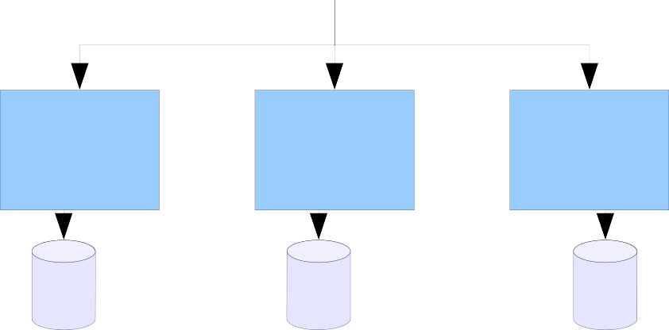
JDBC overview
●
JDBC – Java DataBase Connectivity
●
Java base data access technology
provides methods for querying and updating data in database
●
Java application
Java API calls
JDBC library
MySQL JDBC
driver
Oracle JDBC
driver
SQLServer JDBC
driver

Slide 138
JDBC overview(cont.)
●
In JDBC programming, developers typically perform the following steps
obtain a connection to the remote database server
create and prepare SQL statement for execution
execute SQL statement
obtain the return result set and work with it
disconnect from the remote database

Slide 139
JDBC overview(cont.)
●
The driver is loaded by his name
●
String type - it is usually a parameter
"com.mysql.jdbc.Driver"
●
the developer don't know the database used
●
The database is selected by a pseudo URL
●
DriverManager is responsible for establish the connection to the database through the driver
the name and location of database is given as a URL
jdbc:mysql://localhost:3306/bovoyage
●
protocol
sub-protocol
machine holding the database
path to the database on the machine

Slide 140
JDBC overview(cont.)
●
Database connection pooling
●
when a web application uses JDBC
–
a physical JDBC connection is establish between the application and the database
●
via a TCP/IP connection
–
establish such a connection is
●
CPU-intensive memory-intensive
execution time-intensive
●
●
–
how long hold the connection
●
request ? session ?
●

Slide 141
JDBC overview(cont.)
●
Database connection pooling
●
connection pooling reduces expensive session establish times
–
connects, disconnects and reconnects
●
a pool of physical connections is created when the system starts up
when the application requires a connection one of these physical connection is provided
when the application "closes" the connection
●
●
–
–
it is disconnected
the physical connection is merely returned to the pool

Slide 142
JDBC overview(cont.)
●
Database connection pooling
Database connections pool manager
web application

Slide 143
JDBC overview(cont.)
●
The pool manager
●
creates the initial physical connections
manages the distribution of the physical connections
●
–
–
the web application receive a logical connection
closing a logical connection does not close the physical connection
●
returns and close physical connections handles any exception or error
●

Slide 144
JDBC overview(cont.)
●
The pool manager functionality may be provided by
●
an application server
–
Tomcat, JBoss, Geronimo, GlassFish, …
●
a third-party pool manager vendor a JDBC driver vendor
●
●
Tomcat enables running web application to :
●
access JDBC data sources using JNDI lookup use connection pooling value-added service
●

Slide 145
Configuring the database connection
making the resource available only to the web application in the specified context
in the <GlobalNamingResources> section in the
server.xml file
●
The database connection is configured as a JNDI resource
●
as part of the <Context> element
–
●
–
the resource will be available to all the web applications deployed on the Tomcat instance

Slide 146
Configuring the database connection(cont.)
●
JNDI resource for MySQL
<Context reloadable="true">
<Resource
name='jdbc/bovoyage' auth='Container' type='javax.sql.DataSource'
driverClassName='com.mysql.jdbc.Driver'
url='jdbc:mysql:///bovoyage' username='toto' password='totopw' maxActive='20'
maxIdle='10'
maxWait='10000' removeAbandoned='true' />
</Context>

Slide 147
Configuring the database connection(cont.)
name : the name of the resource will be used to reference the same resource in the web application
auth : specifies whether the sign-on to the resource manager to access to the resource is done by
●
key attributes
●
●
–
–
the server, "Container" value
th application, "Application" value
●
type : type of resource factory
driverClassName : the database vendor class name
●

Slide 148
Configuring the database connection(cont.)
●
key attributes
●
url : database connection URL
usename and password : for database connection
validationQuery : the server executes this query each time just before it passes the connection to the application, to check the accessibility of the database
maxActive : maximum number of active connections
maxIdle : maximum number of connections that should be kept in the pool at all times
●
●
●
●

Slide 149
Accessing the JNDI DataSource
●
The JNDI DataSource resource is available in Tomcat
We need to create a reference to the configured JNDI resource in the web deployment descriptor web.xml
●
<resource-ref>
<res-ref-name>jdbc/bovoyage</res-ref-name>
<res-type>javax.sql.DataSource</res-type>
<res-auth>Container</res-auth>
</resource-ref>

Slide 150
Accessing the JNDI DataSource
the name specified is relative to the root naming context, which is define as java:comp/env
the name of the resource is jdbc/bovoyage
the full JNDI name of the resource will be
java:comp/env/jdbc/bovoyage
●
JNDI
●
●
●
Context contexteJndi = new InitialContext();
DataSource dataSource = (DataSource) contexteJndi.lookup("java:comp/env/jdbc/bovoyage");

Slide 151
Security
version 1.1

Slide 152
Security Realms
●
Mechanism for protecting web application resources.
●
a resource is protected with a defined security constraint
–
user role that can access to the resource
●
Tomcat's realm is
●
collection of user names and passwords collection of roles associated with each user
●

Slide 153
Security Realm
MemoryRealm : simple implementation that uses an xml file (tomcat-users.xml)
JDBCRealm : supports storing username, passwords and roles in a SQL database
JNDIRealm : implementation backed by JNDI
DataSourceRealm : realm backed by a JNDIconfigured JDBC datasource
UserDatabaseRealm : realm backed by a custom
UserDatabase configured by JNDI
●
Realm available in Tomcat
●
●
●
●
●

Slide 154
Security Realm
CombinedRealm : realm that allows usage of multiple realm at the same time
LockOutRealm : extends CombinedRealm, to lock out users if too many incorrect login tries are detected
●
Realm available in Tomcat
●
JaasRealm : authentication using JAAS
–
Java Authentication and Authorization Service
●
●
–
prevent pure force server attack

Slide 155
Memory Realm
●
The simplest realm available in Tomcat
●
uses an in-memory database which is read from an XML file
–
on server startup
<tomcat-users>
<role rolename="tomcat" />
<role rolename="role1" />
<user username="tomcat" password="tomcat" roles="tomcat" />
<user username="both" password="tomcat" roles="tomcat,role1" />
<user username="role1" password="tomcat" roles="role1" />
</tomcat-users>

Slide 156
Memory Realm(cont.)
●
Protected a resource with a MemoryRealm
●
enable MemoryRealm in the conf/server.xml file
●
in Engine, Host or Context element
●
Engine : for all the web applications
Host : for all the web applications within that host Context : only this web application
●
●
<Realm className="org.apache.catalina.realm.MemoryRealm" />
●
configure the application to use the configured MemoryRealm
●
in the web.xml
●
add a security constraint define a login mechanism
declare the roles used by the security constraint
●
●

Slide 157
Memory Realm(cont.)
●
Configure the application
●
add the security constraint in the web.xml file
<security-constraint>
<web-resource-collection>
<web-resource-name>Administration</web-resource-name>
<description>Exemple de sécurisation de ressources WEB</description>
<url-pattern>/admin/*</url-pattern>
</web-resource-collection>
<auth-constraint>
<role-name>admin</role-name>
</auth-constraint>
</security-constraint>

Slide 158
Memory Realm(cont.)
●
Configure the application
●
define the login mechanism in the web.xml file
<login-config>
<auth-method>BASIC</auth-method>
<realm-name>Site exemple</realm-name>
</login-config>
●
declare the roles used
–
in the web.xml file
<security-role>
<role-name>admin</role-name>
</security-role>

Slide 159
Memory Realm(cont.)
●
Restart Tomcat to apply the changes Navigate the browser to the URL
●
●
a login windows is shown in the browser

Slide 160
Authentication types
●
BASIC
●
client authenticates by entering a username and password
the browser sends the informations in plain text, Base64 encoded
●
●
DIGEST
●
similarly to BASIC
username and password are digested-encoded using MD5
●

Slide 161
Authentication types(cont.)
●
FORM
●
client authenticates using a HTML form
input filed names and form action are defined as part of Java Servlet specification
the sending mechanism are customizable
–
●
●
CLIENT_CERT
●
uses SSL (Secure Socket Layer)
client and server have their own SSL certificate uses a mutual authentication
●
●

Slide 162
LockOutRealm
●
Protection against the brute force attacks
●
the LockOutRealm wraps another realm
how many failed attempts
how long the user will be lock out (in seconds)
<Realm className="org.apache.catalina.realm.LockOutRealm" faiureCount="3" lockoutTime="3600">
<Realm className="org.apache.catalina.realm.MemoryRealm" />
</Realm>

Slide 163
UserDatabaseRealm
●
Advanced version of MemoryRealm
●
can be configurable via JNDI
that allows clients to lookup objects by the know name in the server.xml
●
●
<GlobalNamingResources>
<Resource auth="Container" description="User database that can be updated and saved" factory="org.apache.catalina.users.MemoryUserDatabaseFactory" name="UserDatabase" pathname="conf/tomcat-users.xml" type="org.apache.catalina.UserDatabase"/>
</GlobalNamingResources>
●
and used by the Context
<Realm className="org.apache.catalina.realm.UserDatabaseRealm" resourceName="UserDatabase"/>

Slide 164
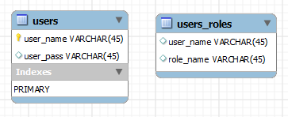
JDBCRealm
●
Simple like the MemoryRealm, but the JDBCRealm
stores all the informations in a
user-defined and JDBC-compliant database
●
we need two tables
–
–
one for user and password one for user and role

Slide 165
DataSourceRealm
allows configuration of the database connection as the JNDI resource
similar to UserDataBaseRealm which is a JNDI configurable version of MemoryRealm
●
DataSourceRealm is the upgraded version of
JDBCRealm
●
●

Slide 166
DataSourceRealm(cont.)
●
Configuring DataSourceRealm in server.xml file
<GlobalNamingResources>
<Resource name="jdbc/authority" auth="Container" type="javax.sql.DataSource"
maxActive="100" maxIdle="30" maxWait="10000"
username="toto" password="totopw"
driverClassName="com.mysql.jdbc.Driver" url="jdbc:mysql://localhost:3306/authenticate" />
</GlobalNamingResources>
●
Configuring DataSourceRealm in the Context
<Realm className="org.apache.catalina.realm.DataSourceRealm" dataSourceName="jdbc/authority"
userTable="users" userNameCol="user_name" userCredCol="user_pass" userRoleTable="user_roles" roleNameCol="role_name" />

Slide 167
FORM-Based authentication
●
A user request a protected resource
●
a login form is displayed
–
the user can enter a username and password
●
Tomcat checks the entered details
–
if the entered user credentials are match in the realm
●
user is authenticated
–
if the user has the required role the required page is displayed
●
authorization
–
if user does not have the role, an error page is displayed
●
code 403

Slide 168
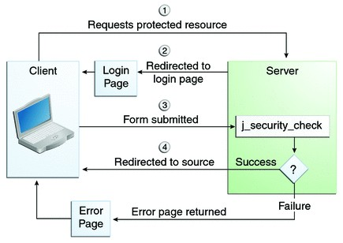
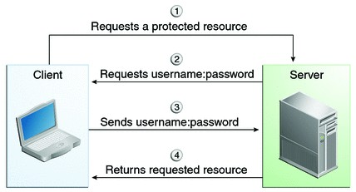
FORM-Based authentication(cont.)
BASIC authenticate
FORM authenticate

Slide 169
FORM-Based authentication(cont.)
●
Configuration
●
create a login page create an error page configure web.xml
●
●

Slide 170
FORM-Based authentication(cont.)
●
Login page
Java Servlet specification
<html>
<head>
<meta http-equiv="Content-Type" content="text/html; charset=ISO-8859-1">
<title>Login</title>
</head>
<body>
<form action="j_security_check" method="POST">
<table>
<tr><td>Username: </td><td><input type="text" name="j_username" /></td></tr>
<tr><td>Password: </td><td><input type="password" name="j_password" /></td></tr>
<tr><td colspan="2"><input type="submit" value="ENVOYER" /></td></tr>
</table>
</form>
</body>
</html>

Slide 171
FORM-Based authentication(cont.)
●
Error page
<html>
<head>
<meta http-equiv="Content-Type" content="text/html; charset=ISO-8859-1">
<title>Error</title>
</head>
<body>
<h3>Incorrect auth</h3>
</body>
</html>

Slide 172
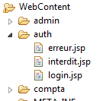
FORM-Based authentication(cont.)
●
Configuration in the web.xml file
<login-config>
<auth-method>FORM</auth-method>
<form-login-config>
<form-login-page>/auth/login.jsp</form-login-page>
<form-error-page>/auth/error.jsp</form-error-page>
</form-login-config>
</login-config>

Slide 173
DIGEST authenticate
●
UserDataBaseRealm can be configure to use DIGEST authenticate
●
of course, the others realms can be secure in the same way
we need to
●
–
select the DIGEST algorithm
●
in the server.xml file
–
–
create the DIGEST password add this password to the Realm
●
here the tomcat-users.xml file
–
configure the login-config
●
in the web.xml file

Slide 174
DIGEST authenticate
●
Select the DIGEST algorithm
●
in server.xml file
<Realm className="org.apache.catalina.realm.UserDatabaseRealm" resourceName="UserDatabase" digest="sha"/>
●
Create the DIGEST password
●
Java supports two digest algorithm
–
MD5 and SHA
●
"totopw" is the textplain password
digest -a sha pupkin pupkin:557860fea134517d63080a07c1d507c9dde15621

Slide 175
DIGEST authenticate
●
Add this password to the Realm
●
tomcat-users.xml file
–
old file
<tomcat-users>
<role rolename="admin" />
<user username="pupkin" password="pupkin" roles="admin" />
</tomcat-users>
now
<tomcat-users>
<role rolename="admin" />
<user username="pupkin" roles="admin"
password="557860fea134517d63080a07c1d507c9dde15621" />
</tomcat-users>
–
●
Configure the login-config
●
web.xml file
<login-config>
<auth-method>DIGEST</auth-method>
<realm-name>Site example</realm-name>
</login-config>

Slide 176
Securing with SSL
●
SSL – Secure Socket Layer
●
was first developed by Netscape
–
more recently the IETF developed TSL – Transport Level Security is based on SSL
●
IETF : Internet Engineering Task Force
●
guarantee that no one can eavesdrop on or tamper with the communication between a browser and a server
SSL is a cryptographic protocol
●
–
using symmetric pair of keys to encrypt and decrypt traffic

Slide 177






Securing with SSL(cont)
●
Symmetric pair of keys
●
a same key is used for encryption of plaintext and decryption of ciphertext
the same key is shared
encryption
decryption
Alice
?
Bob
stole the key
Chuck

Slide 178
Securing with SSL(cont)
●
Symmetric pair of keys
●
the algorithms are fast the algorithms are simple
how to share the key ????
●
●

Slide 179
Securing with SSL(cont)
●
Asymmetric pair of keys
●
or public-key cryptography two separate keys
●
–
one is private
●
used for decryption
–
one is public
●
used for encryption this key is shared
●
●
the two keys are generated by a key generation program

Slide 180



Securing with SSL(cont)
●
Asymmetric pair of keys
●
the public key is used for encryption of plaintext the private key is used for decryption of ciphertext
●
encryption
decryption
Alice
?
Bob
stole the key

Slide 181
Securing with SSL(cont)
●
Digital certificate
●
contains keys a serial number
the owner's name validity period
●
●
●
●
Keystore
●
contains multiple certificates, keys

Slide 182
Securing with SSL(cont)
Navigator
Web server
hello
symmetric key generation
encryption
decryption
decryption encryption
decryption encryption
all the messages use a symmetric encryption

Slide 183
Securing with SSL(cont)
●
Configuring Tomcat with SSL
●
create our own certificate
–
self-signed certificate
●
it will not be verified with an independent CA (Certificate Authority)
–
the certificates are stored in a repository called keystore
●
configuring Tomcat's SSL connector configuring resources in web application
●
–
forcing Tomcat send resources over SSL

Slide 184
Securing with SSL(cont)
●
Create a self-signed certificate
●
use keytool
–
JAVA_HOME/bin
–
keytool -genkeypair -alias tomcat -keylag RSA -keystore <TOMCAT_HOME>/conf/tomcat.keystore
●
enter the required details
tomcat.keystore file with its is own password
keystore
each certificate has an alias and a password
certificate 1
certificate 2
certificate n

Slide 185
Securing with SSL(cont)
●
Configuring Tomcat's SSL connector
●
in server.xml file
<Connector port="8443" protocol="HTTP/1.1"
SSLEnabled="true" maxThreads="150"
used by HttpServletRequest.isSecure()
scheme="https" secure="true"
no use of CLIENT_CERT
clientAuth="false"
sslProtocol="TLS" keystoreFile="conf/tomcat.keystore" keystorePass="azerty" keyAlias="tomcat"
keyPass="abc123" />

Slide 186
Securing with SSL(cont)
●
Configuring resources in web application
●
in the web.xml
<security-constraint>
<web-resource-collection>
<web-resource-name>Administration</web-resource-name>
<url-pattern>/admin/*</url-pattern>
</web-resource-collection>
<auth-constraint>
<role-name>admin</role-name>
</auth-constraint>
<user-data-constraint>
<transport-guarantee>CONFIDENTIAL</transport-guarantee>
</user-data-constraint>
</security-constraint>
server.xml
<Connector connectionTimeout="20000" port="8080" protocol="HTTP/1.1"
redirectPort="8443" />

Slide 187
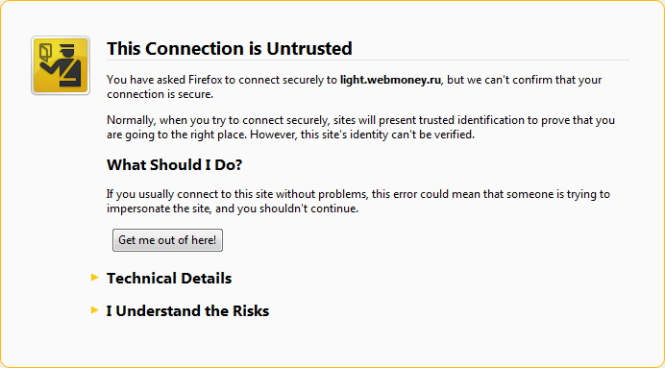
Securing with SSL(cont)
●
Try the URL … and accept the security alert

Slide 189
JSP 2.2 – JSP Property Group changes
Three new configuration settings
<jsp-config>
<jsp-property-group>
<url-pattern>*.jsp</url-pattern>
<default-content-type>text/html</default-content-type>
</jsp-property-group>
<jsp-property-group>
<url-pattern>*.jsp</url-pattern>
<buffer>4096</buffer>
</jsp-property-group>
<jsp-property-group>
<url-pattern>*.jsp</url-pattern>
<error-on-undeclared-namespace>
true
</error-on-undeclared-namespace>
</jsp-property-group>
</jsp-config>

Slide 190

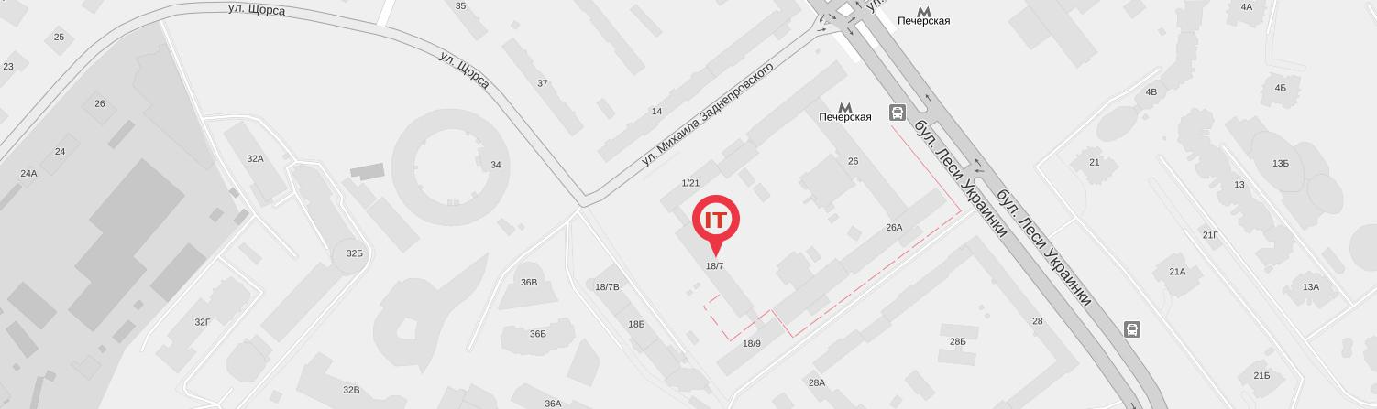
КОНТАКТНЫЕ ДАННЫЕ
ITEA
ул. Кутузова, 18/7, оф. 301
Киев
03133
+38 044 590 08 38
info@iteducate.com.ua
www.iteducate.com.ua
https://www.facebook.com/ITeducate

